Slide 1
Reducing Preventable Perinatal Harm to Decrease Malpractice Claims William Riley, Mac McCullough and Cecile Dinh. Arizona State University Les Meredith and Rebecca Price, Premier, Inc 8th Annual Keeneland Conference Public Health Systems and Services Research Lexington, Kentucky April 22, 2015
AHRQ Patient Safety & Medical Liability Grant 1R18HS019587
Notes:
Kristi will open the session and give initial introductions and welcome.

Slide 2
Specific Aims
Aim 1: Achieve 100% compliance with specific interventions to standardize care and NTS shown to improve perinatal patient safety
Aim 2: Eliminate the incidence of preventable perinatal harm
Aim 3: Reduce malpractice events claims and payouts for perinatal injury

Slide 3
Methods: Design
Prospective cohort study design to conduct interventions and collect data on bundle compliance, harm and other clinical outcomes in 20 hospitals (12 intervention, 8 non-equivalent control) over the period July 1, 2008 to December 31, 2012.
Baseline 2006-2007
588,000 deliveries (370,000 intervention, 218,000 comparison)
Data Collection on malpractice outcomes from January 1, 2006 to December 31, 2014.
Period reported for malpractice data collection: 2006-2009

Slide 4
Phase I participating hospitals
Arizona
North Mountain Hospital (Phoenix,)*
John C. Lincoln Health Network
Illinois
Methodist Medical Center of Illinois (Peoria)
Kentucky
Baptist Hospital East (Louisville)
Baptist Healthcare System
Massachusetts
Baystate Medical Center (Springfield)
Baystate Health
Minnesota
Fairview Ridges Hospital (Burnsville)
Univ. of Minnesota Medical Center (Minneapolis)
Fairview Health System
New Mexico
Presbyterian Hospital (Albuquerque)
Presbyterian Healthcare Services
*Hospital did not continue in PPSI Phase II
Ohio
Bethesda North Hospital (Cincinnati)
Good Samaritan Hospital (Cincinnati)
TriHealth
Akron City Hospital (Akron)
Summa Health System
Tennessee
Indian Path Medical Center (Kingsport)
Mountain States Health Alliance
Texas
Harris Methodist Fort Worth Hospital (Forth Worth)
Presbyterian Hospital of Dallas (Dallas)
Texas Health Resources
Washington
St. Joseph Hospital (Bellingham)
PeaceHealth
Wisconsin
West Allis Memorial Hospital (West Allis)
Aurora Health Care
West Virginia
City Hospital (Martinsburg)*
West Virginia United
Notes:
Here is a list of the 16 hospitals participating in the initiative.
The hospitals are located in 12 states, and are comprised of large and small, rural and urban, and teaching and non-teaching facilities.

Slide 5
Results: Aim 1
Aim 1 (Achieve 100 % compliance with specific interventions shown to improve perinatal patient safety)

Slide 6
PPSI Clinical Care Bundles
Elective Induction
Gestational age > 39 weeks
Normal fetal status (per NICHD tiers) prior to start of oxytocin
Pelvic exam prior to start of oxytocin
Recognition and management of tachysystole
Augmentation
Documentation of estimated fetal weight
Normal fetal status (per NICHD tiers)
Pelvic exam prior to the start of Oxytocin
Recognition and management of tachysystole
Vacuum
Alternative labor strategies considered
Prepared patient
Maximum application time and number of pop-offs predetermined and documented
Cesarean and resuscitation teams available at delivery
High probability of success
“High Reliability Goal:” Provide all elements of each bundle to 90% of patients

Slide 7
Induction bundle compliance
Tachysystole element (light blue) presents challenges for this bundle average

Slide 8
Results: Aim 2
Aim 2:Eliminate the incidence of preventable perinatal harm

Slide 9
Harm measures
The Adverse Outcome Index (AOI) measures the volume and magnitude of 10 types of potentially preventable adverse events – maternal and newborn.
Maternal: Neonate:
Maternal death Birth trauma*
Uterine rupture Admission to NICU
Return to OR/L&D (>2500g & for >24hours)
3º or 4º perineal tear Apgar score <7 at 5 mins
Maternal admission to ICU Intrapartum & neonatal Blood transfusion death (>2500g)
*Defined differently than the AHRQ Birth Trauma Patient Safety Indicator PSI 17
Notes:
Our harm measures tell us whether there really has been a reduction in harm as a result of our project. The teams are reporting maternal and neonatal outcome data, which is coded within their billing system, every quarter to the National Perinatal Information Center, or NPIC. NPIC analyzes their data, assists the teams in identifying any erroneous coding issues which could be affecting their scores, and provides the teams with their Adverse Outcomes Index and other harm indices. The Adverse Outcome Index or AOI is the number of deliveries with one or more of these ten adverse events shown on the slide as a proportion of total deliveries.

Slide 10
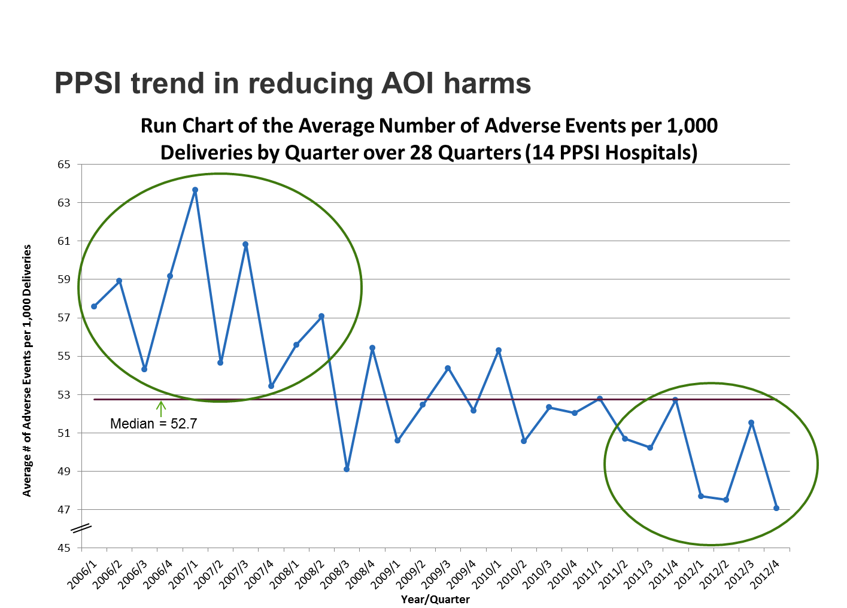
Reducing AOI harms per 1,000 deliveries
*According to run chart technique, observations that fall on the median are discarded from the analysis

Slide 11
Results - Aim 3
Aim 3 Reduce malpractice events claims and payouts for perinatal injury

Slide 12
Four Years (2006-2009)
 | Total | Annual | Per 1,000 Deliveries
Deliveries | 342,727 | 85,682 | --
Number of birth injuries resulting in lawsuit claim | 243 | 61 | 0.71
Number of OB claims paid | 56 | 14 | 0.16
Amount of losses paid for OB cases | $50,946,467 | $12,736,617 | $148,650
Liability paid for OB cases | $44,200,767 | $11,050,192 | $128,968
Legal defense costs paid for OB cases | $6,745,700 | $1,686,425 | $19,682

Slide 13
OB Claims as Percent of Total
 | Total – All Claims | OB Claims Only | OB Share of Total
Number of claims paid | 705 | 56 | 8%
Total amount of losses paid | $247,161,754 | $50,946,467 | 21%
Total indemnity | $182,737,981 | $44,200,767 | 24%
Total legal defense costs | $64,423,773 | $6,745,700 | 10%

Slide 14
Baseline versus Intervention period measures
 | PPSI Hospitals (n=14) |  | Comparison Hospitals (n=8)
 | Baseline (2006-2007) | Intervention (2008-2009) | Baseline (2006-2007) | Intervention (2008-2009)
Average Annual Deliveries | 7,592 | 7,811 | 6,887 | 6,749
OB lawsuit claims per 1,000 deliveries | 1.49 | 1.05 | 0.64 | 0.74
OB claims paid per 1,000 deliveries | 0.26 | 0.16 | 0.20 | 0.23
Total amount of losses paid per 1,000 deliveries | $417,527 | $74,780 | $205,458 | $33,028
Total indemnity per 1,000 deliveries | $381,321 | $35,051 | $180,383 | $23,631
Total legal defense costs per 1,000 deliveries | $36,206 | $39,729 | $25,075 | $9,397

Slide 15
Change in Malpractice Spending from Baseline to Intervention
 | PPSI Hospitals | Comparison Hospitals
Change in annual deliveries | 219 | -138
Change in OB lawsuit claims | -0.29 | 0.10
Change in annual number of OB claims paid | -0.08 | 0.03
Change in annual losses paid for OB claims | -$330,283 | -172,430
Using Wilcoxon Signed-Rank Test:
PPSI Hospitals saw a significant median decrease in total spending on liability for OB claims (p = .03)
Comparison hospitals saw no significant median decrease in total spending on liability for OB claims (p = 0.88)

Slide 16
Change in Malpractice Spending from Baseline to Intervention
 | PPSI Hospitals | Comparison Hospitals
Change in annual losses paid for OB claims | -$330,283 | -172,430
Change in annual indemnity for OB claims | -$340,240 | -156,752
Change in annual legal defense costs for OB claims | $9,957 | -15,678
The decrease in total spending on liability claims in the PPSI group was due entirely to a reduction in the amount spent on indemnity payments.
The amount spent on legal defense actually increased slightly.

Slide 17
Conclusion
It is possible to implement standardized care processes and high reliability, improve perinatal patient safety, and reduce malpractice claims.

Slide 18
Change in Malpractice Spending from Baseline to Intervention
 | PPSI Hospitals | Comparison Hospitals
Change in annual losses paid for OB claims | -$330,283 | -172,430
Change in annual indemnity for OB claims | -$340,240 | -156,752
Change in annual legal defense costs for OB claims | $9,957 | -15,678
The decrease in total spending on liability claims in the PPSI group was due entirely to a reduction in the amount spent on indemnity payments.
The amount spent on legal defense actually increased slightly.
TO DO MAC WILL CHECK ON OTHER SIGNIFICANCE

Slide 19
PPSI timeline
A total of 342,754 deliveries occurred at PPSI hospitals during this time!
Notes:
The PPSI is comprised of three phases.
The Baseline Phase consisted of the retrospective collection of harm outcome data from 2006 and 2007 to establish a baseline of performance for participants.
During Phase 1, which ran from January 2008 through December 2010, hospital teams implemented interventions and actively worked on performance and perinatal safety improvement across approximately 145,000 births.
Phase 2 began in January 2011 and will be completed in December 2012.
In June 2010, AHRQ awarded a demonstration grant to Fairview to extend the initiative…The grant allowed for the Phase 2 extension, which focuses on additional quality improvement and data analysis components by PIMS, Fairview and the University of Minnesota School of Public Health.
Finally, we’ll report results from Phase 2 and the entire project towards the end of 2013.

